Slide 1
Strings & Character Arrays
Part - 2

Slide 2
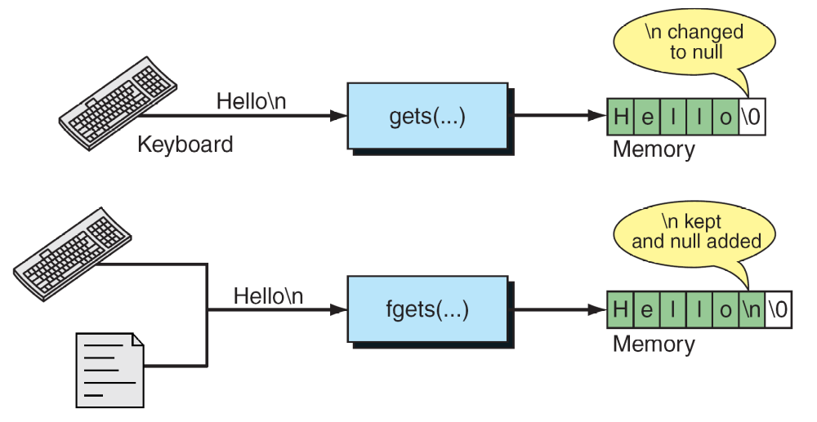
gets() & fgets()
from Figure 11-11 in Forouzan & Gilberg, p. 682

Slide 3
Determining String Length
We can use the strlen() (from string.h) function to determine the length of a string.
It counts the number of characters in a string, excluding the null character.
To use strlen():
strCnt = strlen(myString);

Slide 4
Copying Strings
Remember, we cannot simply assign one string to another due to the that strings are character arrays!
However, we can use the strcpy() function from string.h to copy one string to another:
strcpy(destinationStr, sourceStr);

Slide 5
Comparing Strings
We can use the strcmp() function, from string.h, to compare two strings:
strcmp(str1, str2) …
If the two strings are equal, strcmp() returns 0.
If str1 is greater than str2, strcmp() returns a positive number.
If str1 is less than str2, strcmp() returns a negative number.

Slide 6
Comparing Strings
from Figure 11-17 in Forouzan & Gilberg, p. 698

Slide 7
Combining Strings
We can use the strcat() function to combine two strings into a new string.
We need to be certain that the array to which we assign the resulting string is large enough to hold all the characters from the two contributing strings.
To use strcat():
strcat(str1, str2);
The above example adds the value of str2 to the end of str1, replacing the delimiter of str1.

Slide 8
Other Built-in Functions
strcat();
strncat();
strchr();
strcmp();
strncmp();
memchr();
memcmp();
memcpy();
memmove();
memset();

Slide 9
Other Built-in Functions
strlen();
strpbrk();
strrchr();
strspn();
strstr();
strtok();
strcoll();
strcpy();
strncpy();
strcspn();
strerror();
strxfrm();

Slide 10
Questions?

